Slide 1

Multiple Linear Regression Analysis of Ames Housing Data: A Machine Learning Approach for Determining Valuable Housing Features
Presentation by Brian Perez & Matthew Harris

Slide 2
Project Objective
The central aim of this project was to provide insights for potential home builders & home renovators
A multiple linear regression model was implemented to determine which housing features were the most significant drivers of price values

Slide 3
Overview of Housing Data
The Ames Housing dataset contains the sale information of 2580 houses in Ames, Iowa between the years 2006 to 2010
The dataset contains 82 columns with information regarding the numerous aspects of each sold home such as the size, quality, and condition of many of the housing features

Slide 4
Pre-Processing of the Data: Missing Values
There are 12,254 missing values, so prior to analysis, these missing values were imputed
Many NAs corresponded to houses that lacked a particular feature
NAs also corresponded to houses that had no size value

Slide 5
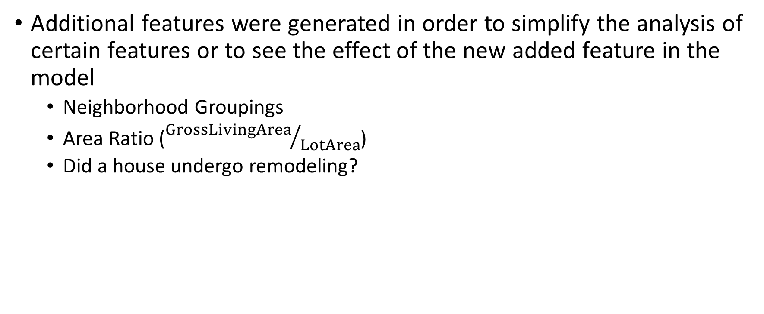
Pre-Processing of the Data: Feature Engineering
Additional features were generated in order to simplify the analysis of certain features or to see the effect of the new added feature in the model
Neighborhood Groupings
Area Ratio (${GrossLivingArea}/{LotArea}$)
Did a house undergo remodeling?

Slide 6
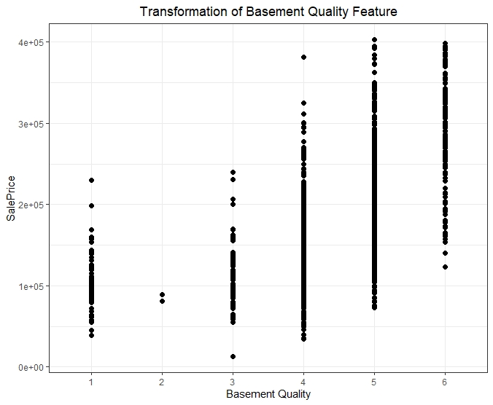
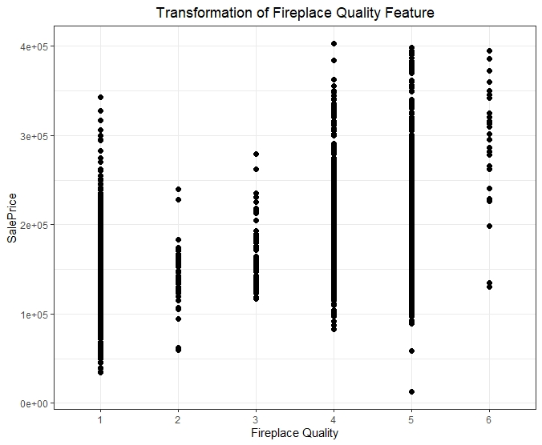
Pre-Processing: Categorical Feature Conversions

Slide 7
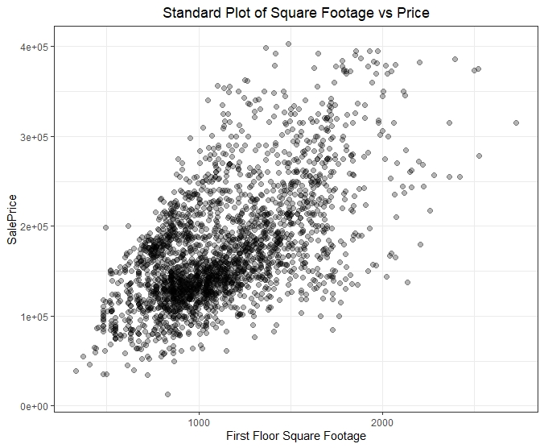
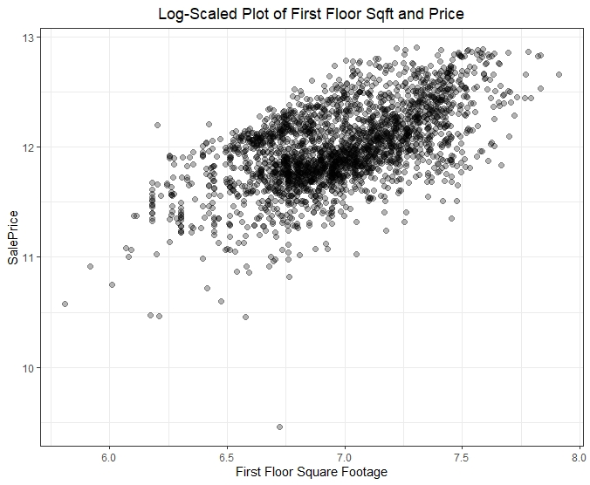
Pre-Processing of the Data: Feature Scaling

Slide 8
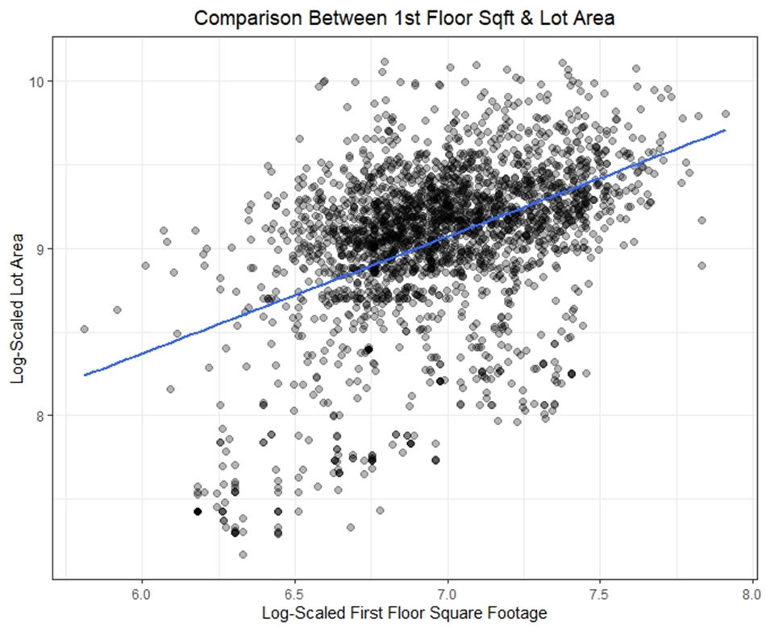
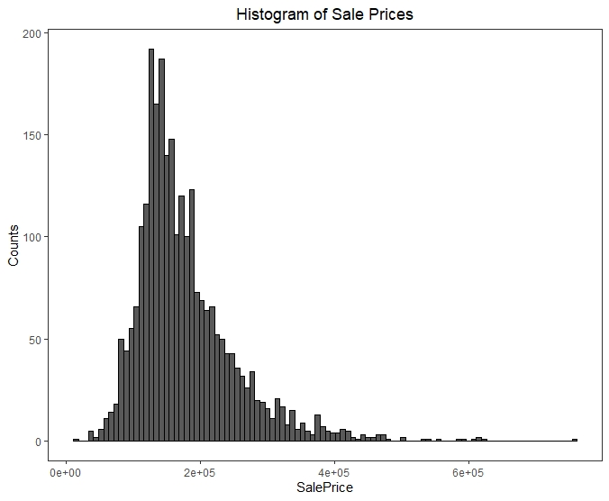
Pre-Processing: Feature Selection Process

Slide 9
Model Training: Stepwise Regression with Bayesian Information Criteria Penalty
Divide data in 80/20 split
Using all features in the train dataset, apply backwards stepwise regression with BIC penalty
Repeated stepwise regression with BIC criteria to develop the final model
Confirmed results via cross-validation

Slide 10
Model Training: Results of the Final Model
Important Features Derived from Stepwise Regression:
Basement Quality
1st Floor Square Footage
2nd Floor Square Footage
Exterior Quality
Exterior Condition
Garage Quality
Kitchen Quality
Neighborhood Group
Heating Quality
Adjusted R-Squared: 0.8427
Cross-Validation Results
RMSE: 0.1452
R-Squared: 0.838

Slide 11
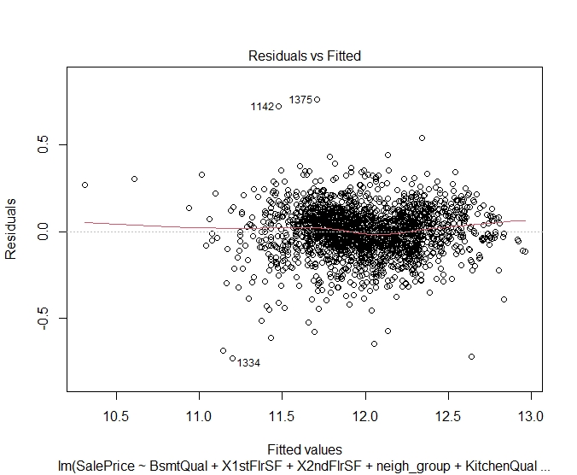
Model Diagnostics: Evaluation of Constant Variance Among Residuals
Estimated values & their associated residuals
Examines whether predicted values have any non-linear behavior
Does not indicate any trend in plot

Slide 12
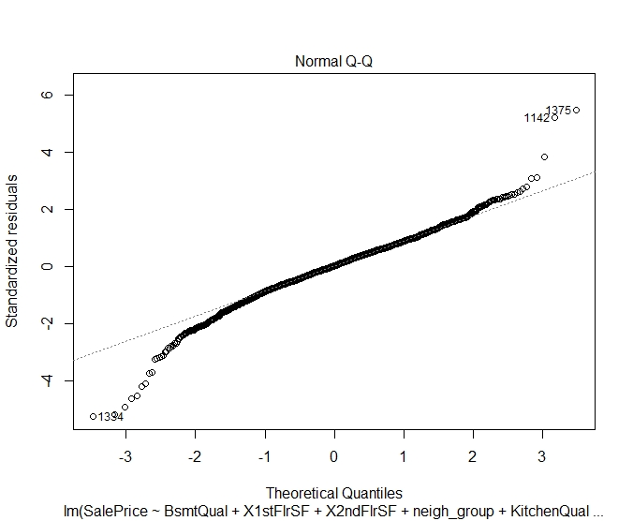
Model Diagnostics: Distribution of Residuals
QQ plot of the standardized residuals produced by the linear model
Normal behavior in the center of the distribution but skews towards the ends

Slide 13
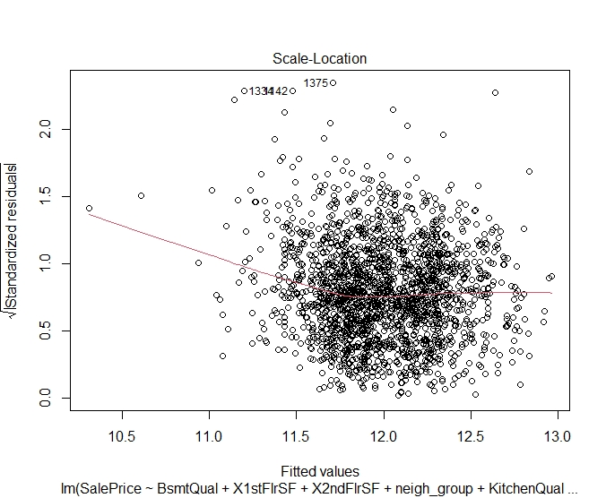
Model Diagnostics: Evaluation of Heteroskedasticity
Fitted values are plotted against the standardized residuals
Aims to show any sort of pattern in variance
For the most part, residuals shows large random pattern across values

Slide 14
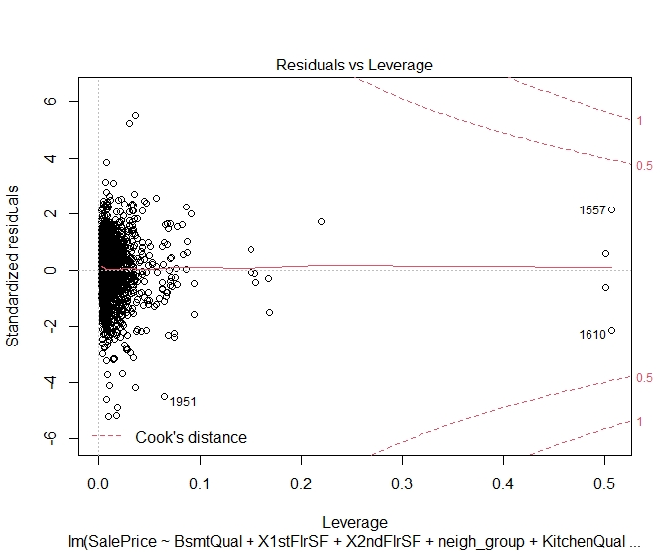
Model Diagnostics: Evaluation of Impactful Outliers & Leverage Points
Leverage vs the standardized residuals
Predictions cluster at around a leverage of zero
Some outliers, but none that indicate major influence in model

Slide 15
Summary of Model Diagnostics
Overall, the assumptions of linear regression are upheld in this model
No non-linear trends present in model
Distribution of residuals is mostly normal
Constant variance and independence of errors
No critical points influencing overall model
Coefficients can now be analyzed/interpreted in context with the data

Slide 16
Reviewing Coefficients of the Final Variables
model = log(SalePrice) ~ BsmtQual + log(X1stFlrSF) + log(X2ndFlrSF) + neigh_group + KitchenQual + ExterQual + GarageQual + HeatingQC + ExterCond
Important: Sale Price was log transformed
Extracting value from the coefficients is difficult
y=exp(β0)exp(β1x). . .
Small changes in the log scale heavily impact the sale price
Ordinal dummy variables complicate interpretation further
Magnitudes of coefficients provide insights

Slide 17
Where should you spend your money?
Buyers/Builders
How should I build my house?
What features provide lasting value?
Sellers/Flippers
How should I get my house ready for sale?
What constitutes a house of good value?

Slide 18
Square Footage – Builders, Take Note
First floor - the largest coefficient at 0.55
Maximize first floor square footage as a builder
Second floor – significant, but low coefficient at 0.04
Possibly avoid as a builder; focus on other areas
Ranch styles, etc
But, square footage is difficult to alter in terms of buying/selling
Could indicate good/bad value for buyers

Slide 19
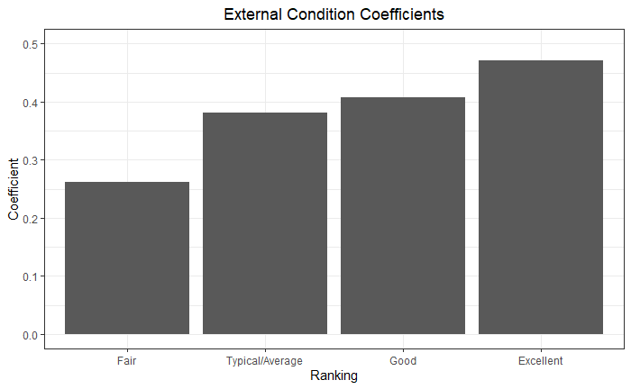
Condition and Quality – External Condition
Most important categorical feature
0.47 for ‘Excellent’
Takeaway: ensure the exterior is of a high level
Curb appeal is extremely important to home value

Slide 20
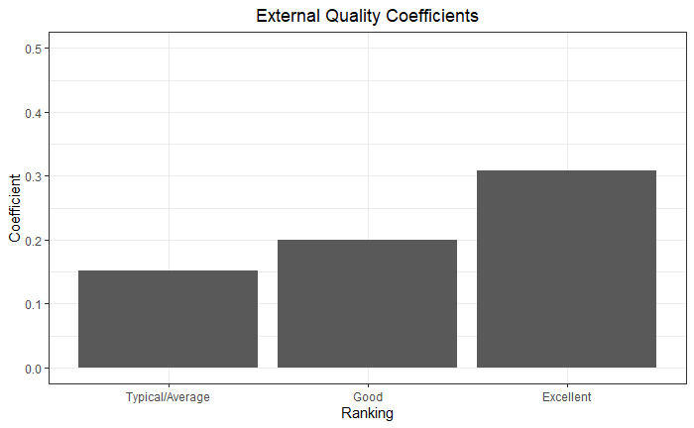
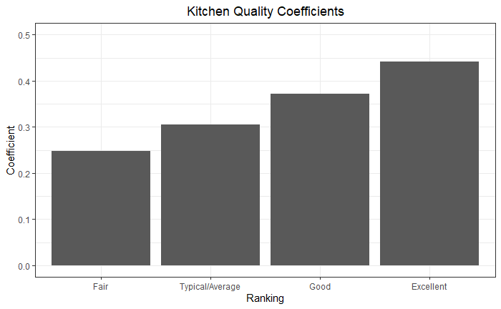
External Quality and Kitchen Quality

Slide 21
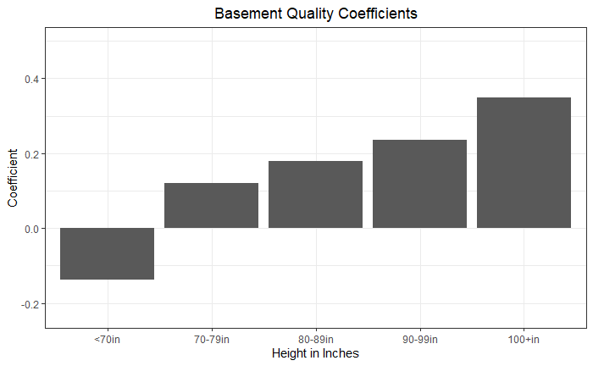
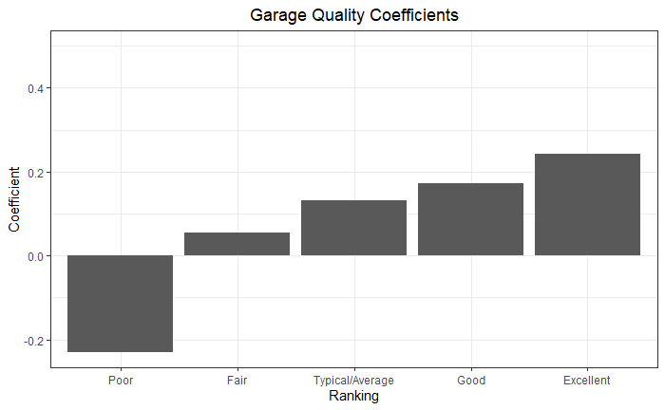
Basement(height) and Garage Quality

Slide 22
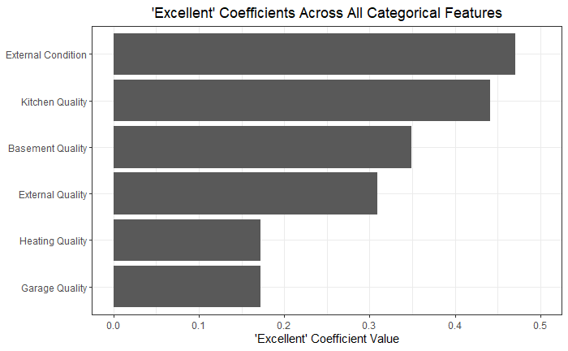
“Excellent” Coefficients of all Categoricals
Prioritize External Condition and Kitchen Quality
Ensure Heating Quality is of adequate standard
Improve low quality garages

Slide 23
Ramification Summary for Buyers/Sellers
Buyers/Builders:
Beware short basements and low quality garages
Maximize first floor square footage
Use quality materials on exterior that won’t degrade over time
Sellers/Flippers:
Houses with poor garages may provide great flip opportunity
Beware short basements
Focus on kitchen and maximizing curb appeal

Slide 24
Potential for Future Research
Expand model to Predictive
Adv Modeling: Random Forrest
Add focus on distance to school, university, or shopping areas
Combine location data
Determine feature distribution across neighborhoods
Using a more recent data set:
Explore the impact of COVID
Effect of 2014 University housing shortage
COVID rates in Ames have been some of the highest in the world

